Slide 1
PIMA DIABETES DATASET ANALYSIS AND INVESTIGATION
Gloria Hawkins-Roberts
Media Design School

Slide 2
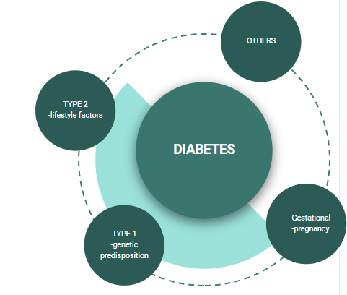
PROJECT TOPIC
-DIABETES
-TYPES
-SYMPTOMS
Notes:
I'm focusing on diabetes, a prevalent non-communicable disease characterized by high blood glucose levels. While there are about 12 subtypes, the most prominent are type one, type two, and gestational diabetes. Type one results from the pancreas not producing insulin, often due to an autoimmune response and usually diagnosed in childhood. Type two, the most common, arises from the pancreases built up insulin resistance often linked to lifestyle factors. Gestational diabetes occurs during pregnancy.
Risk factors encompass being overweight, age above 45, a family diabetes history, and prior gestational diabetes. Diabetes can lead to severe complications, including heart disease, high blood pressure, and vascular damage.

Slide 3
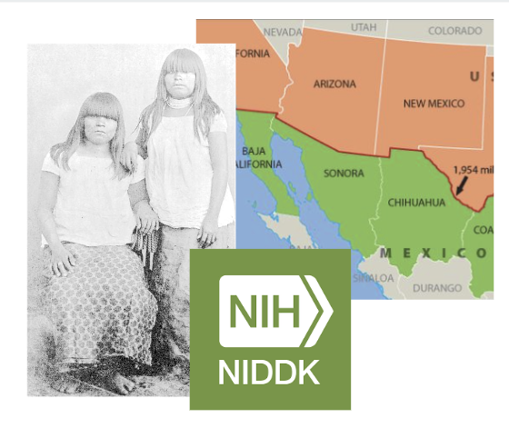

DATASET BACKGROUND:
-SOURCE
-PIMA INDIANS
Notes:
I've chosen the Pima diabetes dataset from Kaggle, focusing on the Pima Indians, a Native American group from Arizona and Mexico, known for their high diabetes prevalence, akin to many indigenous groups. These elevated rates stem from a blend of genetic predispositions, environmental and lifestyle influences, as well as sociocultural and economic factors, all of which interplay complexly. Initiated in 1965, the dataset houses 768 samples from female Pima Indians, aged 21 and above, near Phoenix, Arizona.
https://www.ncbi.nlm.nih.gov/pmc/articles/PMC10103803/#:~:text=Lack%20of%20education%2C%20poverty%2C%20and,more%20commonly%20in%20these%20communities.

Slide 4
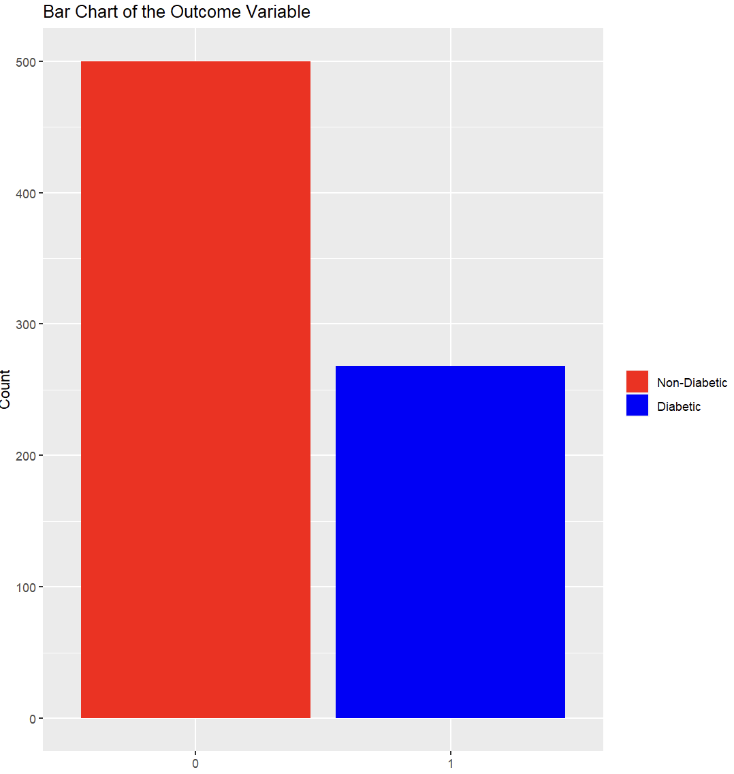
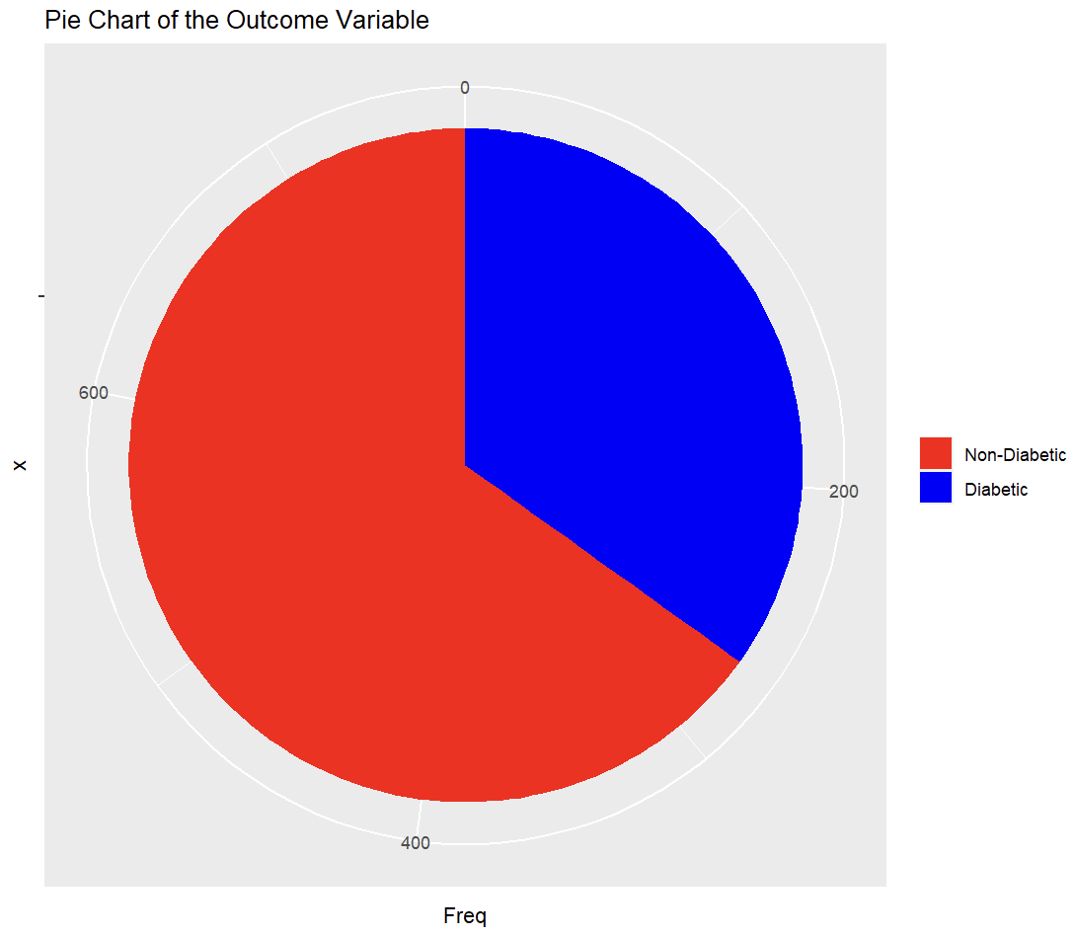
DATASET AT A GLANCE
-9 VARIABLES
-VARIABLES
-INDEPENDENT AND DEPENDENT VARIABLES
Notes:
The chosen dataset does not focus on the specific type of diabetes but rather some of the predictor variables. There are a mix of dependent and independent variables in this dataset:
In terms of the datasets variables, the independent variables are:; number of pregnancies (number of times pregnant), plasma glucose level (concentration of plasma glucose, 2hr oral glucose tolerance test), blood pressure (diastolic blood pressure, mm Hg), skin thickness (mm), body Mass Index (BMI, your weight divided by your height squared), diabetes pedigree function (family history of diabetes), Age (years), Insulin (2-hr serum (U/ml), and the dependent variable: outcome of diabetes (1:yes/0:no).
Interestingly, all predictor variables for this dataset are medical. Given the scope of the data set being set to an indigenous group (as previously mentioned) that is more prone to diabetes, even though BMI is included which can allow me to somewhat infer lifestyle factors it would be nice to have definitive values included for socioeconomic and lifestyle variables.
Before looking cleaning I decided to look into the dataset by creating a quick bar char and pie chart - this showed me that there dataset was imbalance because there are significantly more samples of non-diabetics than diabetics.

Slide 5
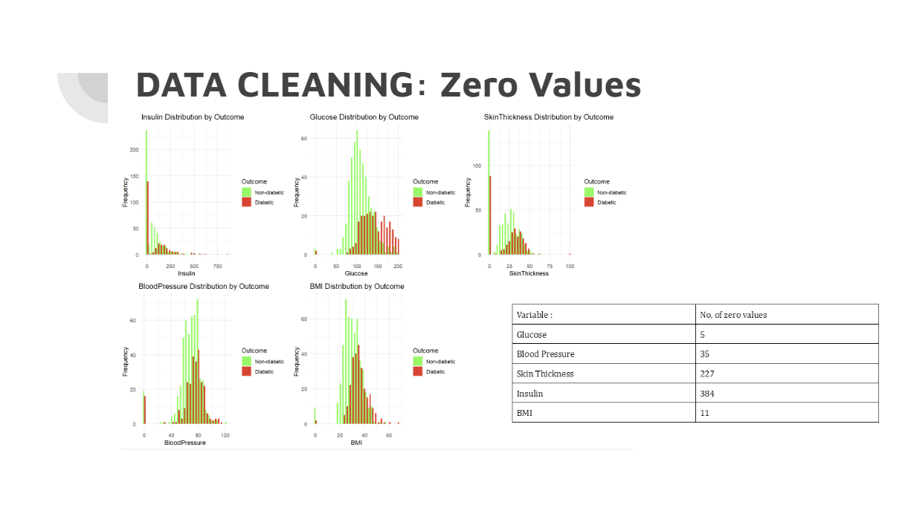
Notes:
HISTOGRAMS
Upon examining the CSV file, I observed zero values in 6 independent variables. I retained zeros for pregnancies, as they are more than likely. However, zero values for skin thickness, BMI, and plasma glucose seemed unlikely. Given that many zero glucose readings were associated with diabetes, I opted to replace them. Usually, high glucose would be associated with diabetes. Interestingly, insulin had the most zero values, often tied with non-diabetic outcomes, prompting their replacement and usually non-diabetics would have insulin values well above 0.
Because missing values can reduce the statistical power and data representation of the dataset I decided that I would replace the notable zero values with either the mean or median, for this I utilized the rule of the mean for balanced data and the median for skewed data. This would ensure that I was not being lead to any invalid conclusions through my visualisations and eventual t-tests.Preliminary histograms revealed slight skews in all variables, leading to the use of medians for replacements.Even though some of them seem somewhat normal, they are either slightly skewed to the left or right and it is more accurate to replace with the median in this situation than the mean.

Slide 6
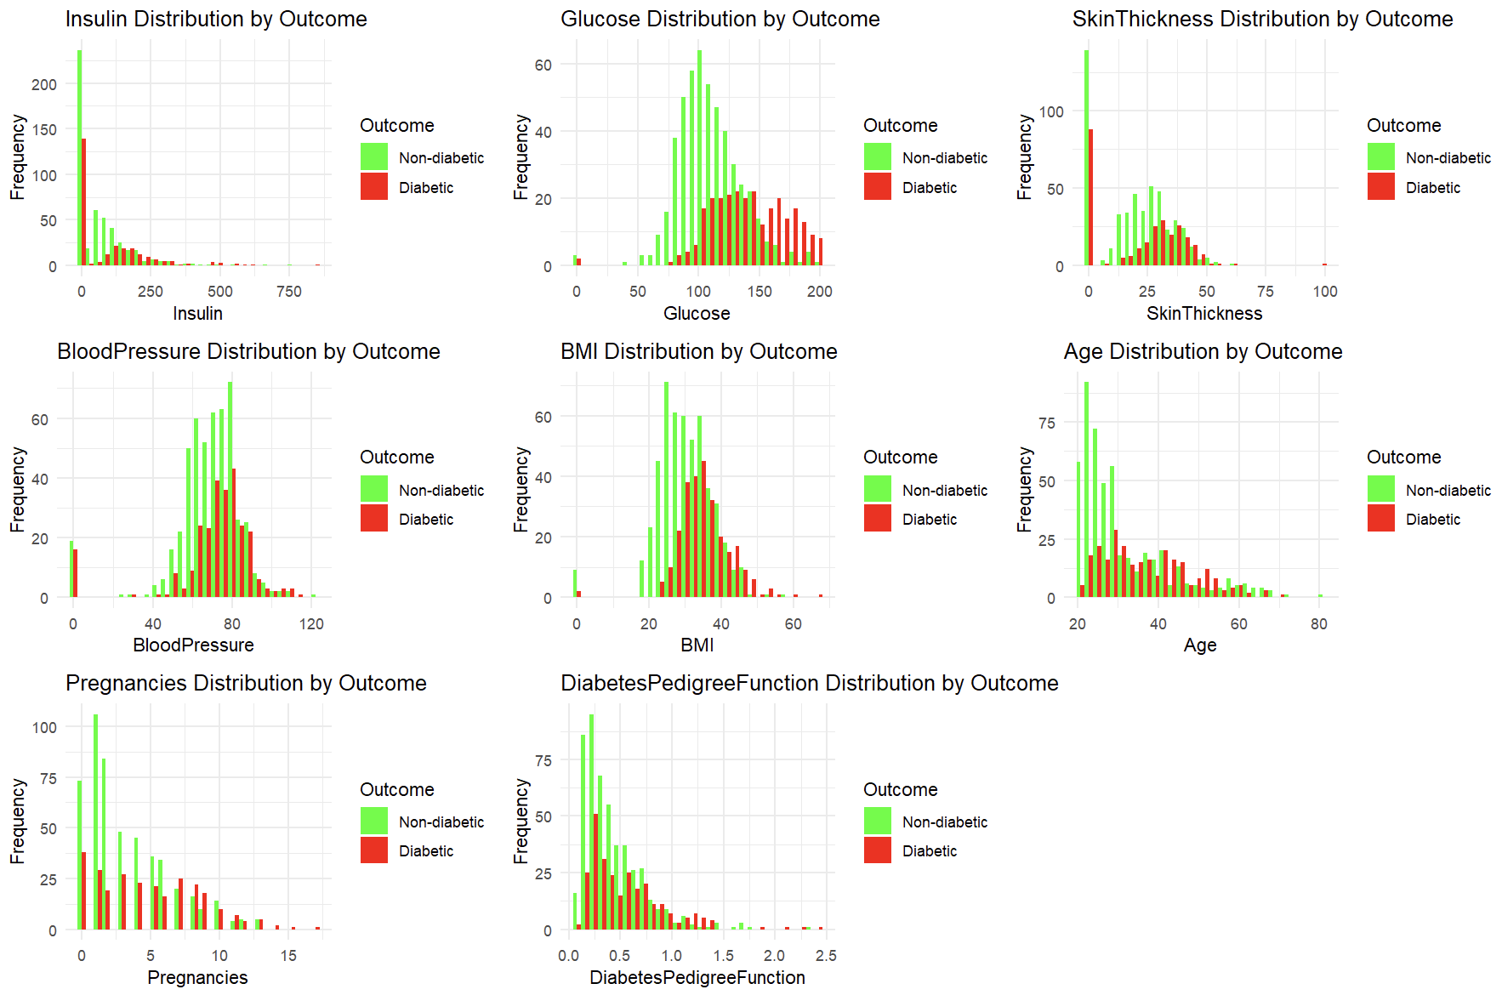
Data Cleaning: OUTLIERS
-OUTLIERS
-Testing
-REMOVAL?
Notes:
I also employed outlier detection for data cleaning. While the Z-test is common for this purpose, the non-normal distribution of my data (as seen on the slide) led me to use the interquartile range method. This is because IQR is robust against non-normally distributed data and it doesn't assume a normal shape whereas z-tests do. IQR is also less sensitive to outliers
While balancing the dataset was a consideration, it isn't crucial for hypothesis testing since it doesn't alter the group mean, which is my primary metric for testing. This would be more appropriate for machine learning

Slide 7
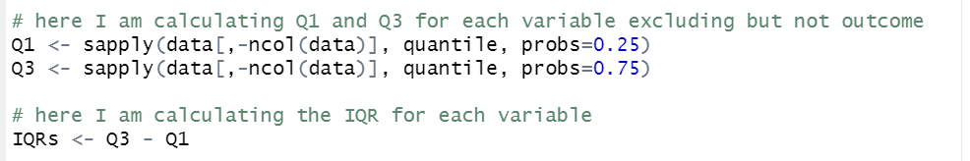
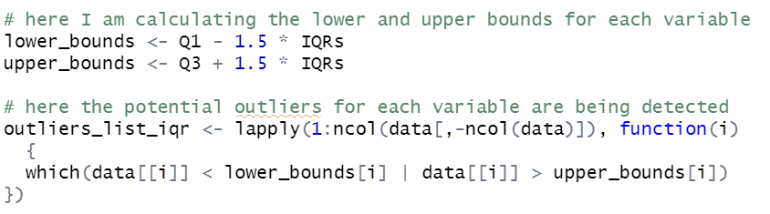
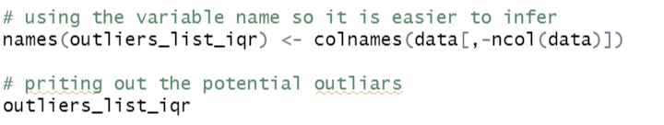
Data Cleaning: OUTLIERS
-OUTLIERS
-TESTING
-REMOVAL?
Notes:
Here you can see the process behind this.
Firstly i can computing the first quartile and the third quartile for each variable column (apart from the outcome which is removed by -ncol). And then I simply calculate the IQR for each variable.I am then calculating the upper and lower bounds where data outside these points can be considered outliers. I am then detecting each outlier by iterating through each variable by using lapply and checking if the data point lies outside of the bounds I calculated. I then finally add the name of each variable to be printed to make it easier to identify and then print the potential outliers.
I decided that I wouldn’t remove any outliers after observing them as all outliers seemed to be within reasonable natural bounds even though some of them may be extreme.
https://stackoverflow.com/questions/49090357/iqr-outlier-in-r

Slide 8
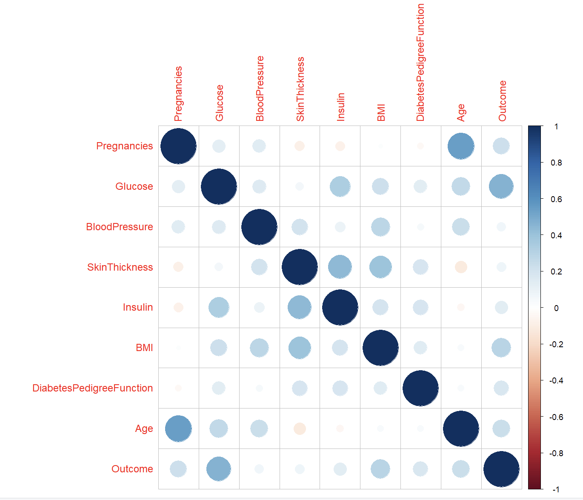
CORRELATION
Notes:
Here is a correlation matrix, post cleaning that displays the relationships between variables. It can be observed that insulin and glucose have a stronger correlation, insulin and skin thickness, and BMI and outcomes. These are just some of the notable relationships, relationships such as age and pregnancies, though they do have a high correlation does not tell us much about diabetes itself. I used this correlations matrix for further investigation.

Slide 9
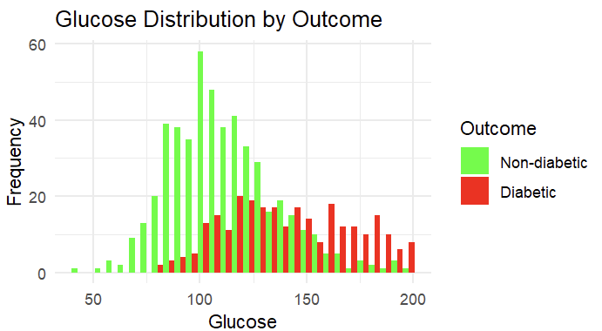
NOTABLE VARIABLES: GLUCOSE
Notes:
HISTOGRAMS
I will now talk about some of the notable variables that I wanted to explore further and hypothesize. The skew for glucose is slightly to the right for both non-diabetics and diabetics along with tails to the right suggesting the exceptional high glucose levels (outliers). Diabetic individuals tend to have higher glucose levels which reflects upon a characteristic of diabetes which is high blood sugar, this would be worth investigating further - I wonder if I can say this confidently leads to diabetes? And I wonder if this has anything to do with insulin

Slide 10
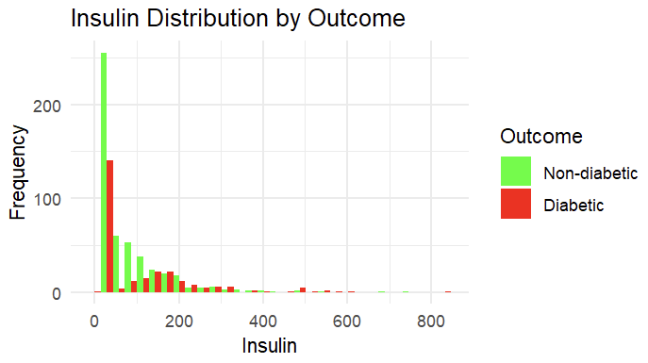
NOTABLE VARIABLES: INSULIN
Notes:
Both distributions are right skewed with long tails (particularly for diabetic individuals which indicated to me that higher insulin did in fact influence diabetes). Most non-diabetic individuals seem to have insulin levels clustered toward the lower end (the left), diabetic patients have a range of insulin levels.
This suggests that while low insulin levels are common in both groups, diabetic individuals tend to exhibit a wider range of insulin levels.
-most diabetics have lower insulin

Slide 11
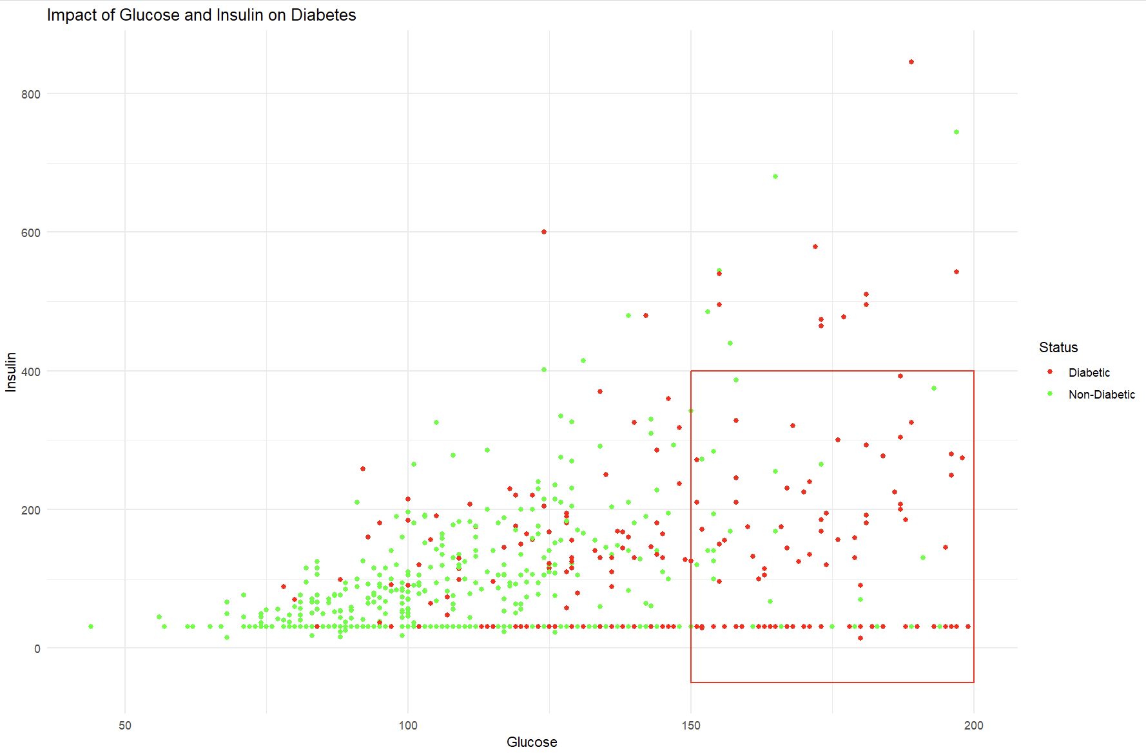
Notes:
This is a scatter plot that answers my question: does the effect of glucose on diabetes have anyhing to do with insulin?
There is a cluster of non diabetics whose insulin remains lower at around 50-200. However as the insulin and glucose variables move away from the cluster to the right, there tends to be more diabetics than non diabetics. The insulin in these cases is either extremely low or extremely high. Hyperinsulinemia could be a reason behind this, this is when the amount of insulin in the blood is beyond what would be considered healthy. Hyperinsulinemia is most commonly associated with diabetes type 2, on its own it is not considered diabetes.

Slide 12
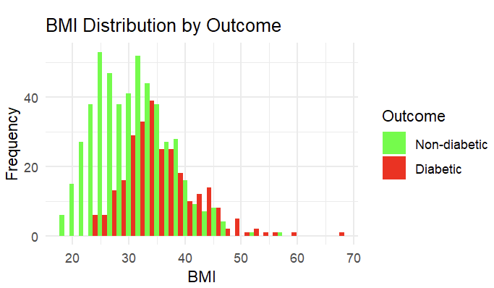
NOTABLE VARIABLES: BMI
Notes:
BMI is the only variable that acts as a lifestyle factor. Both distributions show a right skew however a more pronounced skew for the diabetic group. The tail for the diabetic group goes further and has more notable values of higher BMI. despite this both groups have a clutter of a bmi from 25-40, however, diabetics seem to have a wider distribution and their clutter begins within the mid twenties where as the non diabetics begin before the twenties. This suggests that there could be a relationship between BMI and diabetes which is worth investigating- I wonder if different BMI ranges has an impact on diabetes?

Slide 13
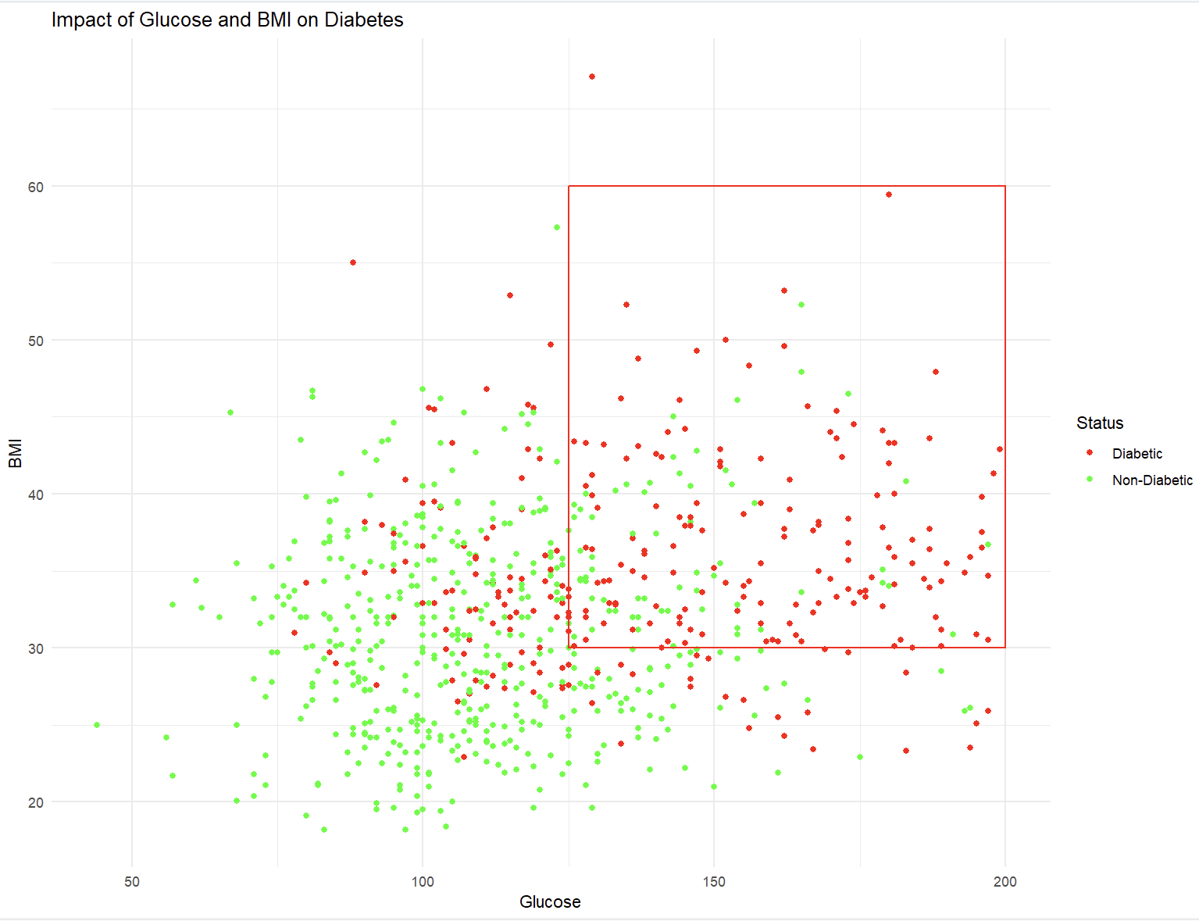
Notes:
I wanted to explore if glucose (thus insulin) has an impact with BMI on diabetes. BMI does not seem to affect the likelihood of diabetes with an impact. There is a cluster of both non diabetics and diabetics within the BMI ranges of 25-45 and plasma glucose of 75-140. However, no one below a BMI of 23 seems to have diabetes. Likewise, it seems like those that do not have diabetes above a BMI of around 48 are outliers. The red box demonstrates where the majority cluster of diabetics are alone from non diabetics, this seems to rely heavily on glucose. However, from an observational standpoint, BMI still plays a smaller role.

Slide 14
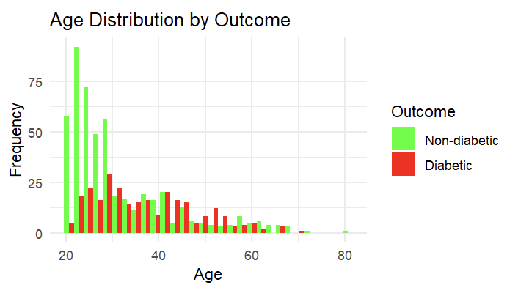
NOTABLE VARIABLES: AGE
Notes:
Both distributions here are right skewed (positive) (particularly the non-diabetic grouping). The non diabetic individuals mostly align with a younger age (cluster), the diabetic group seems to have a broader distribution of age from 20-50 years. This could be a factor but does not seem as significant but is still worth investigating.
More facts:
-beyond the age of 40 there seems to be a noticeable number of diabetics

Slide 15
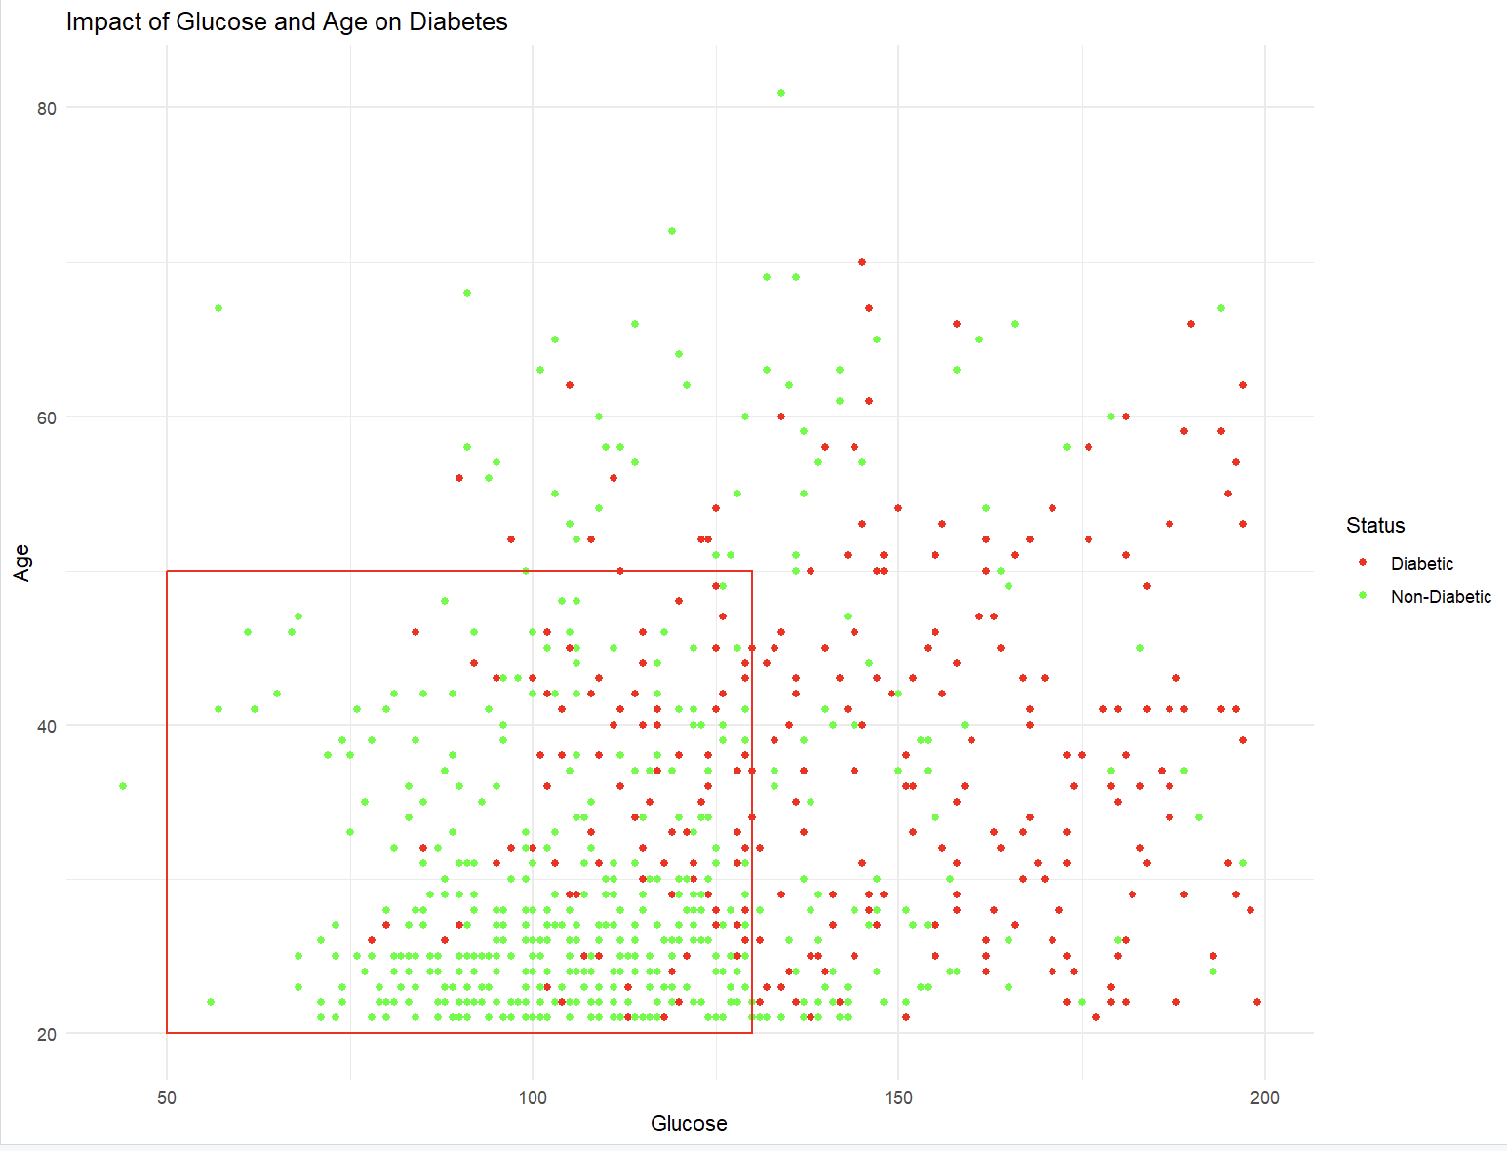
Notes:
I wanted to see if glucose or age drove diabetes more? Within the red box there is a cluster of persons aged 20-early 30’s whose plasma glucose lies between 70-145, the vast majority of this group are non diabetic. However, it can also be observed in the box that as age increases while remaining in the plasma glucose range of 70-145 the risk of developing diabetes seems to increase. It can also be noted that outside of the red box from 155-200 plasma glucose that the risk for diabetes is highly reliant on the glucose variable, not age.
Overall glucose seems to be an important factor. However, it is important to note that high plasma glucose is a symptom of diabetes and the underlying cause would actually be the low insulin, even though this may be hard to visualise.

Slide 16
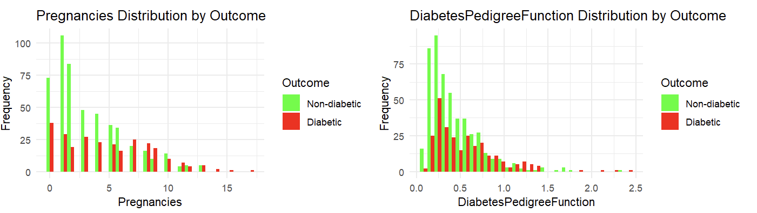
VARIABLES: Less Notable
Notes:
Pregnancies is skewed there is quite an even distribution all round suggesting this isn't a major factor. For diabetes pedigree is is similar in terms of distribution, suggesting this isn't a major factor to consider.
Pregnancies:
-most individuals have fewer than 5 pregnancies
-more pronounced decreased in pregnancies in non-diabetics than diabetics
-more consistent values in pregnancies for diabetic
Diabetes pedigree function:
-very similar distribution between groups
-few diabetic outliers with high DPF

Slide 17
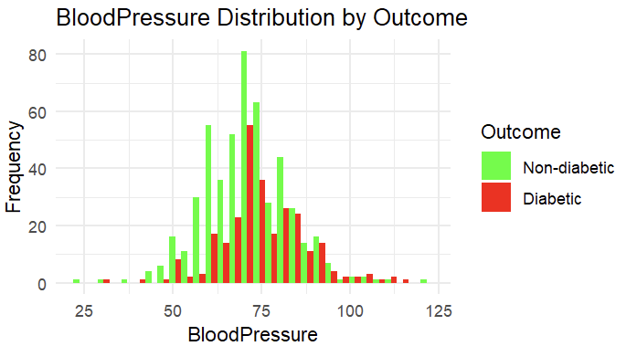
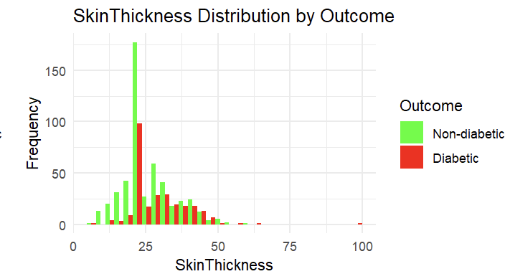
VARIABLES: Less Notable
Notes:
For blood pressure and skin thickness there also doesnt seem to be too much of a difference per group in terms of distribution, again, suggesting that there may not be as much of a correlation between these groups and outcome.

Slide 18
HYPOTHESIS
The likelihood of diabetes increases in those over the age of 45
H0: The likelihood of diabetes is the same for individuals regardless of being above or below the age or 45
H1: The LIkelihood of diabetes increase in individuals over the age of 25
Those with a BMI greater than 35 are more likely to have diabetes
H0: There is no difference in the likelihood of diabetes between individuals with a BMI greater than 35 and those with a BMI less than or equal to 35
H1: Those with a BMI greater than 30 are more likely to have diabetes than those with a BMI less than or equal to 30
High plasma glucose levels leads to diabetes
H0: there is no difference in plasma glucose levels between diabetic and non-diabetic individuals
H1: diabetic individuals have higher plasma glucose compared to non-diabetic individuals
Notes:
I have created hypothesis that test the reality of diabetes symptoms, I was able to draw these hypothesis from the graphs shown
I wanted to see if I could answer some of my questions that I spoke about earlier:
The likelihood of diabetes increases in those over the age of 45
H0: The likelihood of diabetes is the same for individuals regardless of being above or below the age or 45
H1: The LIkelihood of diabetes increase in individuals over the age of 25
Those with a BMI greater than 35 are more likely to have diabetes
H0: The likelihood of diabetes is the same for individuals regardless of whether their BMI is above or below 35
H1: Those with a BMI greater than 30 are more likely to have diabetes than those with a BMI less than or equal to 35
High blood glucose levels leads to diabetes
H0: there is no difference in blood glucose levels between diabetic and non-diabetic individuals
H1: diabetic individuals have higher blood glucose compared to non-diabetic individuals
H0 null hypothesis
H1 alternative hypothesis

Slide 19
HYPOTHESIS TESTING:
“The likelihood of diabetes increases in those over the age of 45”
Welch Two Sample t-test
data: above_45$Outcome and below_or_equal_45$Outcome
t = 3.3872, df = 156.12, p-value = 0.0008935
alternative hypothesis: true difference in means is not equal to 0
95 percent confidence interval:
0.07021722 0.26667978
sample estimates:
mean of x mean of y
0.4915254 0.3230769
"Reject the null hypothesis: The likelihood of diabetes is different for individuals above and below the age of 45. Diabetic proportion for above 45 is 0.491525423728814 and for 45 or below is 0.323076923076923"
Notes:
-here i am using welch two sample t-test because my data set is imbalanced and i have instructed it to not assume equal variances because my variables are not normal
I am using a two sample t-test because i am ultimately comparing two groups due to the two possible outcomes.
t= the t-statistic which measure the difference between the two groups means with standard error
df= the degrees of freedom for the test (because this is not a whole number we know that this is a welch’s t-test
The results from the Welch Two Sample t-test suggest a significant difference in the likelihood of diabetes between two age groups: those above 45 and those 45 or below. With a p-value of 0.00008935, which is much less than the commonly used significance threshold of 0.05, we can reject the null hypothesis, indicating that age plays a role in the prevalence of diabetes. The data reveals that individuals above the age of 45 have a diabetic proportion of approximately 0.4915, while for those aged 45 or below, the proportion is around 0.3231. This suggests that the older age group has a higher rate of diabetes compared to the younger group.
https://www.datacamp.com/tutorial/t-tests-r-tutorial
https://www.rdocumentation.org/packages/stats/versions/3.6.2/topics/t.test

Slide 20
HYPOTHESIS TESTING:
“Those with a BMI greater than 35 are more likely to have diabetes”
Welch Two Sample t-test
data: above_35_BMI$Outcome and below_or_equal_35_BMI$Outcome
t = 4.7577, df = 436.33, p-value = 2.667e-06
alternative hypothesis: true difference in means is not equal to 0
95 percent confidence interval:
0.1052460 0.2534074
sample estimates:
mean of x mean of y
0.4713115 0.2919847
"Reject the null hypothesis: The likelihood of diabetes differs between those with a BMI above 35 and those 35 or below."
Notes:
The results from the Welch Two Sample t-test focus on the relationship between Body Mass Index (BMI) and the likelihood of diabetes. A clear difference emerges when comparing individuals with a BMI above 35 to those with a BMI of 35 or below. The extremely low p-value of 2.667e-06, far below the standard significance threshold of 0.05, leads us to reject the null hypothesis. This underlines a significant distinction between the two BMI groups in terms of diabetes prevalence. Specifically, those with a BMI above 35 have a diabetes rate of approximately 0.4713, whereas for those with a BMI of 35 or below, the rate is closer to 0.2919. This indicates that individuals with a higher BMI are more likely to have diabetes than their counterparts with a lower BMI.
Interestingly, indigenous groups have a significantly higher BMI on average compared to non-indigenous groups which highlights some lifestyle factor differences and a possibility of why diabetes is more prevalent in these groups as I am now able to confirm that BMI is a factor contributing to diabetes.
In terms of BMI and indigenous groups, a 2022 paper has suggested that high BMI in indigenous groups is actually linked to lower socioeconomic status which does give some more insight but nothing too significant and this would be worth further investigation possibly through other datasets.
resources:
.https://www.ncbi.nlm.nih.gov/pmc/articles/PMC8849483/#:~:text=Increased%20BMI%20was%20associated%20with,Indigenous%20and%20non%2DIndigenous%20people.
https://www.ncbi.nlm.nih.gov/pmc/articles/PMC8849483/#:~:text=Compared%20to%20the%20non%2DIndigenous,)%20vs%2027.6(5.5)).
https://www.datacamp.com/tutorial/t-tests-r-tutorial
https://www.rdocumentation.org/packages/stats/versions/3.6.2/topics/t.test

Slide 21
HYPOTHESIS TESTING:
“High plasma glucose levels leads to diabetes”
Welch Two Sample t-test
data: diabetic_data$Glucose and non_diabetic_data$Glucose
t = 14.853, df = 469.08, p-value < 2.2e-16
alternative hypothesis: true difference in means is not equal to 0
95 percent confidence interval:
27.28789 35.60931
sample estimates:
mean of x mean of y
142.1306 110.6820
"Reject the null hypothesis: Diabetic individuals have significantly higher blood glucose levels compared to non-diabetic individuals."
Notes:
t= the t-statistic which measure the difference between the two groups means with standard error
df= the degrees of freedom for the test (because this is not a whole number we know that this is a welch’s t-test
The results from the Welch Two Sample t-test shed light on the difference in blood glucose levels between diabetic and non-diabetic individuals. The p-value, which is less than 2.2e-16, is extremely low, considerably below the standard 0.05 threshold for statistical significance. This allows us to confidently reject the null hypothesis. The findings demonstrate that diabetic individuals have a mean blood glucose level of approximately 142.1306, while non-diabetic individuals average around 110.6820. This significant difference affirms that diabetic individuals typically have higher blood glucose levels compared to their non-diabetic counterparts.
resources:
https://www.datacamp.com/tutorial/t-tests-r-tutorial
https://www.rdocumentation.org/packages/stats/versions/3.6.2/topics/t.test

Slide 22
CONCLUSIONS + IMPROVEMENTS
-PREDICTOR VARIABLES
-HYPOTHESIS
-COMPARING DIFFERENT INDIGENOUS GROUPS
Notes:
From my testing I am able to say with confidence that BMI, Age and glucose have an impact on being diabetic or not within female pima indians - though i was able to answer some questions along the way the t-tests confirmed some of my answers. Though I thought that Age didn’t have much of an impact on diabetes it turns out that it does. I was able to start to explore lifestyle factors through BMI, however, It would be nice to further investigate other factors such as socioeconomic states, without just inference, to see if they also have the same impact on diabetic outcomes.
In understanding diabetes among indigenous groups, it's crucial to consider not only medical indicators but also sociocultural and socioeconomic factors. These dimensions often play pivotal roles and can offer richer insights. Rather than focusing solely on the number of pregnancies, a detailed history, particularly regarding gestational diabetes, would be more enlightening. To further enhance research in this area, future studies should aim to compare various indigenous groups, and incorporate more personalised variables. It would also be nice to compare other indigenous groups and non-indigenous groups to observe the difference and to dive deeper into my hypotheses and queries.

Slide 23
QUESTIONS!
Resources :
Dabral, S. (2021, December 15). What is an Outlier? How to handle and remove them? Algorithms that are affected by outliers. Medium. https://medium.com/analytics-vidhya/what-is-an-outliers-how-to-detect-and-remove-them-which-algorithm-are-sensitive-towards-outliers-2d501993d59
JDRF UK. (2021, October 15). What causes type 1 diabetes? - JDRF, the type 1 diabetes charity. JDRF, the Type 1 Diabetes Charity. https://jdrf.org.uk/information-support/about-type-1-diabetes/causes-of-type-1-diabetes/#:~:text=While%2090%20per%20cent%20of,with%20type%201%20diabetes%20risk.
Kharroubi, A., & Darwish, H. M. (2015). Diabetes mellitus: The epidemic of the century. World Journal of Diabetes, 6(6), 850. https://doi.org/10.4239/wjd.v6.i6.850
Kumar, A. (2023, March 26). Python - Replace Missing Values with Mean, Median & Mode - Data Analytics. Data Analytics. https://vitalflux.com/pandas-impute-missing-values-mean-median-mode/#:~:text=Mean%20imputation%20is%20often%20used,to%20outliers%20than%20the%20mean.
National Institute of Diabetes and Digestive and Kidney Diseases. (2021, July 19). National Institutes of Health (NIH). https://www.nih.gov/about-nih/what-we-do/nih-almanac/national-institute-diabetes-digestive-kidney-diseases-niddk
What is Diabetes? (2023, April 24). Centers for Disease Control and Prevention. https://www.cdc.gov/diabetes/basics/diabetes.html#:~:text=With%20diabetes%2C%20your%20body%20doesn,vision%20loss%2C%20and%20kidney%20disease.
What Is Diabetes? (2023). National Institute of Diabetes and Digestive and Kidney Diseases. https://www.niddk.nih.gov/health-information/diabetes/overview/what-is-diabetes

